Slide 1
Waveform of Resonant EMRIs vs Binary EMRIs
Christopher Goodhart

Slide 2
Purpose
To determine if we can differentiate between the gravitational waveform of two-body EMRIs and resonant EMRIs.

Slide 3
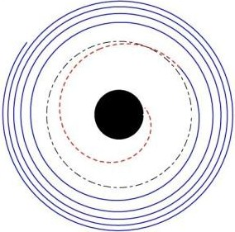
Introduction
EMRI (Extreme Mass Ratio Inspiral)
System of at least two black holes
One is at least 10,000 times more massive
Smaller ones orbits and spirals inward
Orbit decays because it emits gravitational waves

Slide 4
Introduction
Some EMRIS will have multiple smaller bodies
These smaller bodies can form resonant orbits
Ex: Object 1 orbits once when Object 2 orbits twice
Whole number ratio
Different waveform from binary EMRIs
Differentiate between waveforms of resonant and binary EMRIs

Slide 5
Importance
Gravitational waves are a way to see the universe
EMRIs are a great source of gravitational wave signals
Signals have abundant information
Provide us information about black holes (mass, eccentricity, etc.)
Locate supermassive black holes
Locate the EMRI system
Learn about formation of supermassive black holes

Slide 6
Previous Research
One study looked at three-body systems
A massive object, a small object, and an outside tidal force
Did not examine multiple smaller objects
One study looked at a specific type of EMRI
Extreme Mass Ratio Bursts
Highly eccentric orbits emit a burst of signals right before collision
Research on transient resonances
When orbital frequencies (angular frequencies) have integer ratio
Examined impact of resonances on orbit and signals

Slide 7
Method
Use Python to simulate resonant EMRIs
Packages for astrophysics
SciPy
NumPy
AstroPy
AstroPysics
Map the waveform of a resonant EMRI
Compare the waveform of resonant EMRI to binary EMRI
Determine if we can differentiate between the signals

